Slide 1
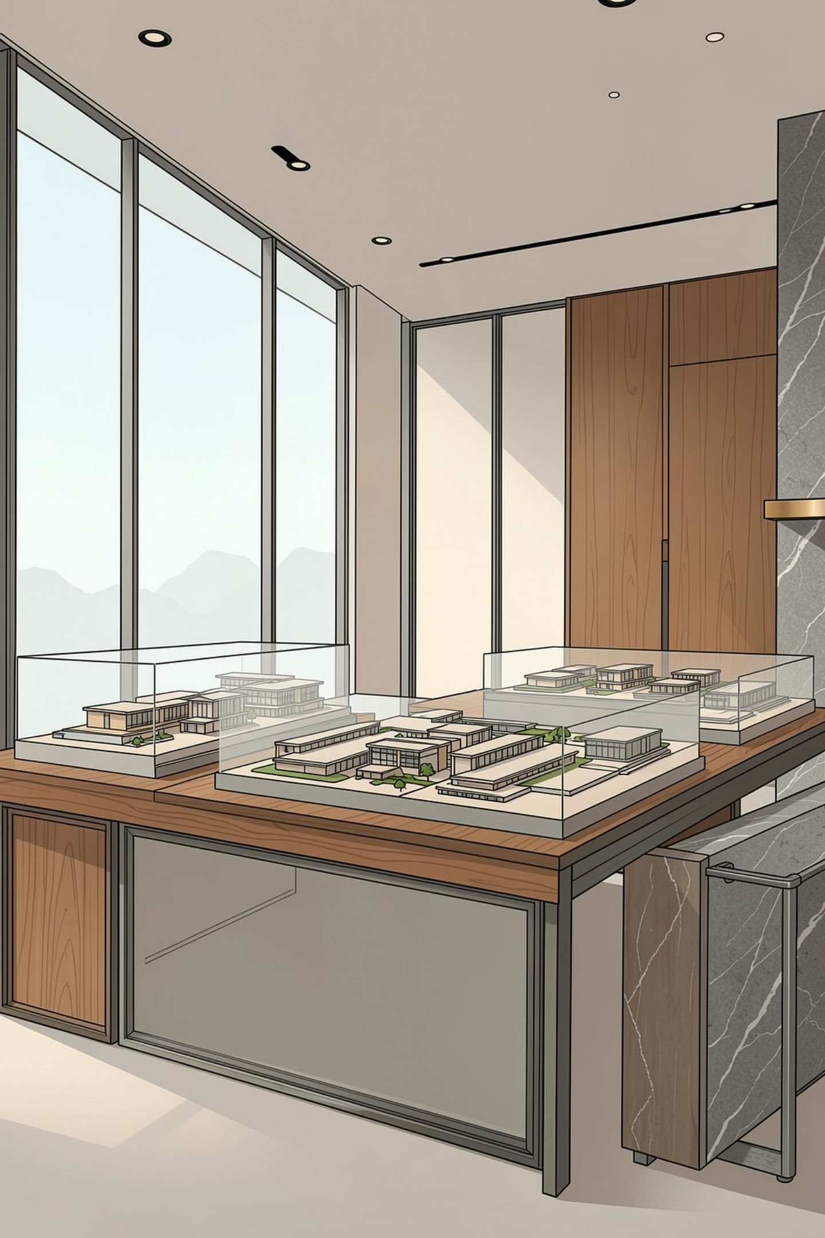


Aastitva Architects
India's Next-Generation Architecture Network
Start your own premium architecture and interior design studio with branding, technology, marketing, and centralized design support.

Slide 2

Why Aastitva?
Premium Brand
Marketing Support
A recognized, trusted name that gives your studio instant credibility in the market.
Dedicated campaigns, brand collateral, and promotional strategy to generate visibility.
Central Design Team
3D Visualization
Access to an experienced in-house design team for guidance on every project.
High-quality 3D renders and walkthroughs to help win client confidence.
Standard Operating System
Business Mentorship
Proven systems and processes for running a profitable design studio.
Ongoing guidance from experienced professionals to help you grow.
PARTNER PROGRAM

Slide 3
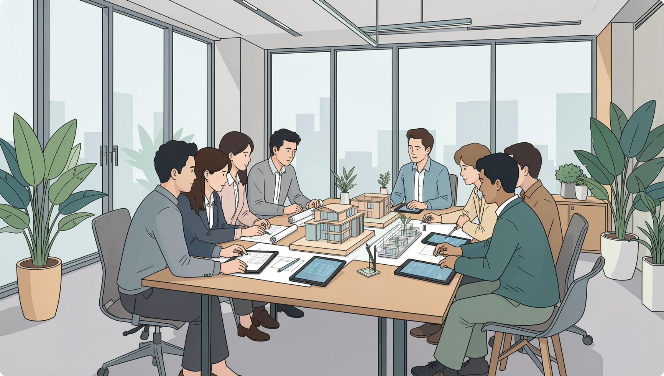
Who Can Join?
Aastitva welcomes professionals and entrepreneurs from allied fields who want to build a design-led business under a trusted brand.
Architects
Civil Engineers
Interior Designers
Builders
Entrepreneurs
PARTNER PROGRAM

Slide 4





What You Get — Studio Essentials
Brand License
Office Design Guidelines
Use of the Aastitva name and identity for your studio.
Standards for setting up a professional studio space.
Website and CRM
Social Media Marketing
Ready-to-use digital tools to manage clients and leads.
Ongoing content and campaign support.
Design Library
Architectural Support
Access to a curated library of design resources and references.
Technical backup from the central design team.
PARTNER PROGRAM

Slide 5





What You Get — Growth Tools
3D Rendering
Technical Training
Sales Training
Professional visualization support for client presentations.
Structured training on design and execution standards.
Skills to convert leads into signed projects.
Lead Generation Assistance
Revenue Opportunities
Multiple streams of income across project types.
Support in building a steady pipeline of clients.
PARTNER PROGRAM

Slide 6
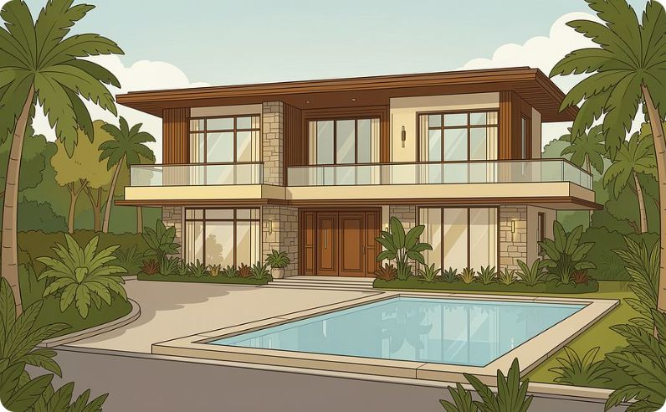
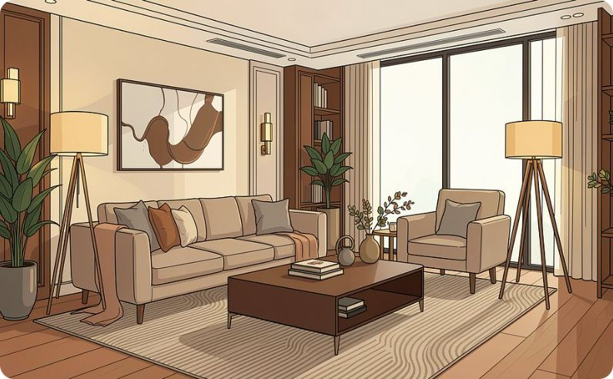

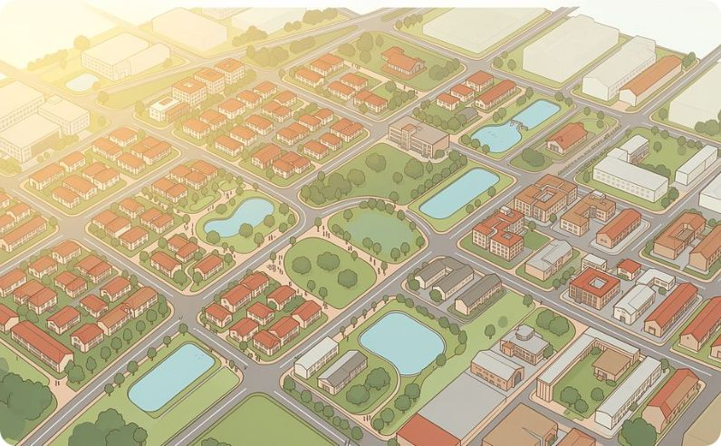
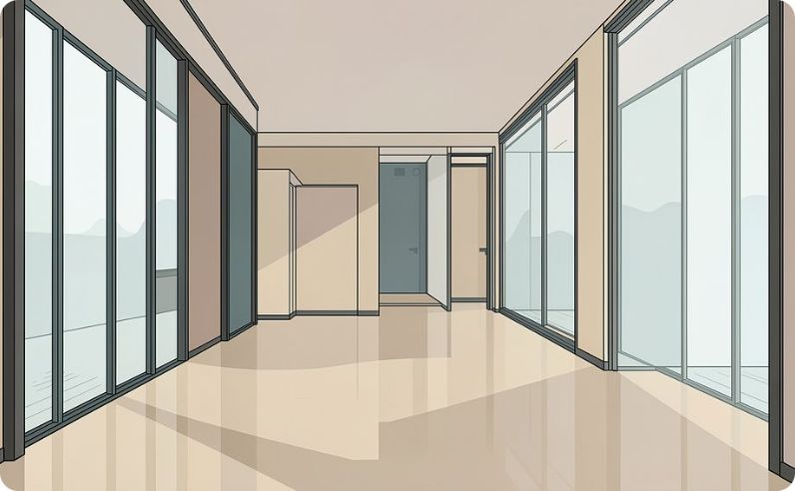

Our Project Expertise
Residential Architecture
Interior Design
Commercial Projects
Township Planning
3D Walkthroughs
Vastu Consultation
PARTNER PROGRAM

Slide 7
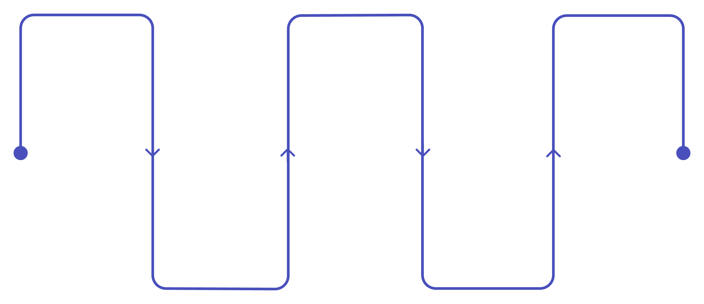
How It Works
Apply
Training
Launch
Submit interest and background
Onboarding in design, tech, business
Go live with brand and marketing support
Interview
Studio Setup
Conversation to assess fit and goals
Guided setup of branded studio
From your first application to a fully operational branded studio, we guide you through every stage of the journey with structured support and expert mentorship.
PARTNER PROGRAM

Slide 8
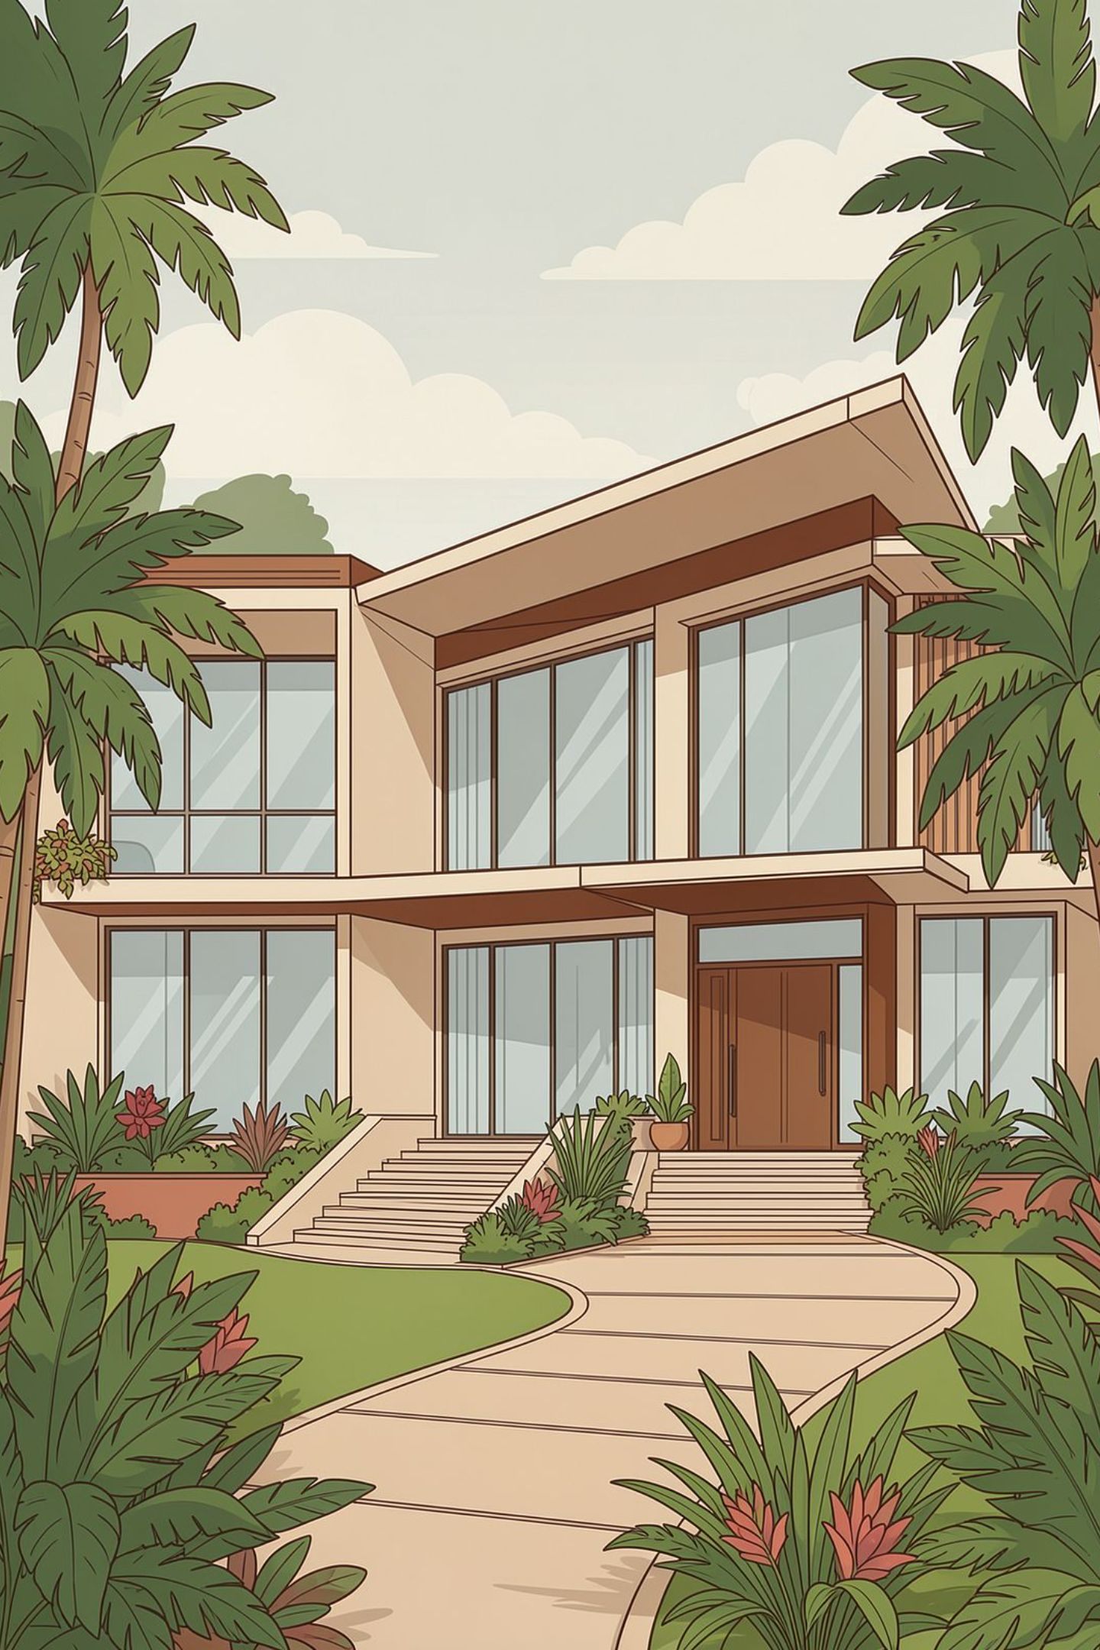
Success Stories
Real projects delivered with a commitment to design excellence and client satisfaction. Showcase completed residential, villa, and commercial projects along with client testimonials that reflect the quality and trust behind the Aastitva name.
As the partner network grows, this section will feature the achievements of individual partner studios across India.
Residential
Commercial
Luxury homes and villas delivered across India.
Offices and retail spaces built to impress.
Client Trust
Testimonials reflecting quality and satisfaction.

Slide 9
Partner Cities Across India
Aastitva is expanding its partner network to key cities across India. Select your city and secure your territory before it is reserved.
North & West India
Central & South India
City
Status
City
Status
Chandigarh
Available
Indore
Coming Soon
Ludhiana
Available
Lucknow
Coming Soon
Amritsar
Available
Surat
Coming Soon
Jaipur
Available
Nagpur
Coming Soon
Jodhpur
Available
PARTNER PROGRAM

Slide 10


Frequently Asked Questions
Do I need to be an architect?
How much investment is required?
No, professionals from allied fields such as civil engineering, interior design, and entrepreneurship are welcome, backed by the central design team.
Investment varies by city and studio scale; details are shared during the interview stage.
What support will I receive?
How long does setup take?
Full support across branding, marketing, design, technical training, and business mentorship.
Typically a few weeks from training completion to studio launch, depending on readiness.
How are projects handled?
What is the royalty model?
Projects are executed jointly, with the partner studio managing client relationships and the central design team providing architectural and technical backup.
A structured royalty model is shared with shortlisted candidates during the partnership discussion.
PARTNER PROGRAM

